Slide 1



SuperStore Sales Dashboard
View in Power BI
Last data refresh:
6/3/2025 8:58:08 AM UTC
Downloaded at:
6/5/2025 11:40:07 AM UTC

Slide 2
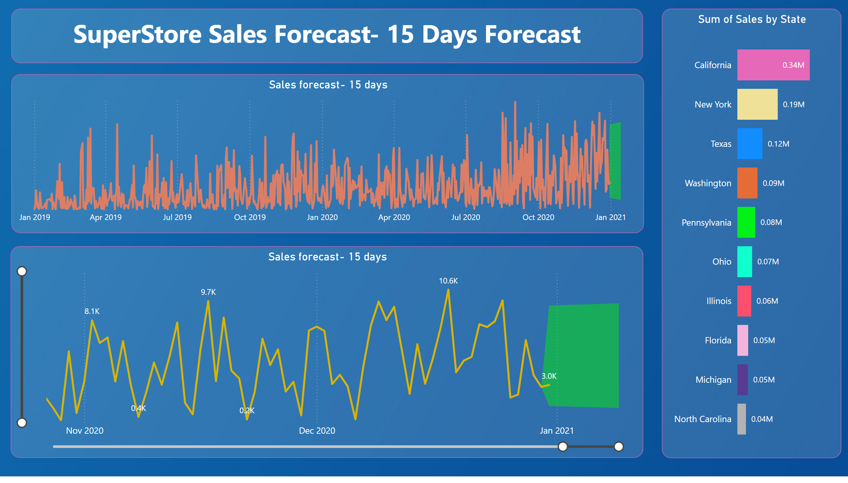
Sales Forecast
Notes:
Sales forecast- 15 days
No alt text provided
Sales forecast- 15 days
No alt text provided
barChart
No alt text provided
textbox
No alt text provided

